Slide 1
Paidy Dataset Exercise
Matthew Jones

Slide 2
Dataset

Slide 3
Data Dictionary
Provided data dictionary:
Variable Name | Description | Type
SeriousDlqin2yrs | Person experienced 90 days past due delinquency or worse | Y/N
RevolvingUtilizationOfUnsecuredLines | Total balance on credit cards and personal lines of credit except real estate and no installment debt like car loans divided by the sum of credit limits | percentage
age | Age of borrower in years | integer
NumberOfTime30-59DaysPastDueNotWorse | Number of times borrower has been 30-59 days past due but no worse in the last 2 years. | integer
DebtRatio | Monthly debt payments, alimony,living costs divided by monthy gross income | percentage
MonthlyIncome | Monthly income | real
NumberOfOpenCreditLinesAndLoans | Number of Open loans (installment like car loan or mortgage) and Lines of credit (e.g. credit cards) | integer
NumberOfTimes90DaysLate | Number of times borrower has been 90 days or more past due. | integer
NumberRealEstateLoansOrLines | Number of mortgage and real estate loans including home equity lines of credit | integer
NumberOfTime60-89DaysPastDueNotWorse | Number of times borrower has been 60-89 days past due but no worse in the last 2 years. | integer
NumberOfDependents | Number of dependents in family excluding themselves (spouse, children etc.) | integer

Slide 4
Dataset Structure
Observation window: Default History
Observation window: Delinquency History
Outcome window
?
- 2 years
Observation point:
Demographic/Credit
+ 2 years
Brief data description:
Target: 90+ days past due within 2 years from observation point
Predictors:
  Customer demographic: Age, income, number of dependents, debt ratio,
  Customer credit: Number of credit lines and credit utilisation
  Customer default history: Number of times 90+ DPD within unknown time frame
  Customer delinquency history: Number of times 1-59/60-89 DPD in last 2 years

Slide 5
Dataset purpose
Because we have:
  General customer level demographic/credit information
  Customer level delinquency history information
  No information regarding any specific loan or application
  Relatively long 2 year outcome window with 90+ dpd target
I believe the purpose of the data is to build a customer level behavioural probability of default model.
Depending on the business/department there may be several uses for such a model:
  Credit score as a product to sell to other financial institutions
  Internal behavioural score for:
    Portfolio credit strategy (Collections strategy, transaction authorisations, limit management, etc..)
    Input into underwriting decisions
    Input into provision calculation/predicting portfolio default rate
I this case I don’t believe the data is from 1 bank/lender as:
  An outcome window of 2 years is generally not used in banking/financial companies as behavioural PDs are usually calculated on a 1 year outcome
  The data is not very granular and has inconsistencies (especially with income/debt related fields) which may be the result of collecting data from multiple sources/businesses

Slide 6
Assumptions
I’ll use the following assumptions about the data as a whole:
The model is to be used as a tool for:
  Predicting portfolio default rates
  Or making accept/reject underwriting decisions
Model performance will be based on 2 key factors:
  GINI/AUC – for an overall measure predictive power
  Lift – to gauge its usefulness for underwriting decisions
All customers have 2 years of observable history (See next page)
Number of times 90+ DPD is also observed over a 2 year period (See next page)

Slide 7
Assumptions
All customers have 2 years of observable history
Age of customers in the data starts from 21 (excluding 1 outlier)
As loans are typically give to over 18s we should have enough data for every customer
Number of times 90+ DPD is also observed over a 2 year period
Average number of times 90+ when plot against age shows no significant decline for younger age groups, in fact the opposite is true
It is likely the variable descriptions are inconsistent for this variable

Slide 8
Data Exploration

Slide 9
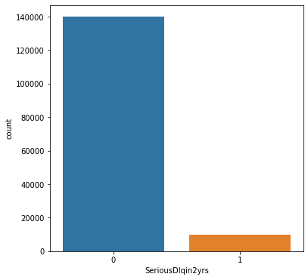
Target: SeriousDlqin2yrs
Description:
90+ days past due with 2 years of the observation point
Sample Default Rate:
6.68%
Comments/Data cleaning:
Binary variable with no missing or unwanted values

Slide 10
Variable: MonthlyIncome
Comments:
Large number of missing/0 data points, the default rate and average age for these customers is not in line with the dataset average. Therefore these cases are most likely not missing at random.
Small number of extreme values, could be either excluded, capped to a maximum value or some kind of transformation employed. In this case I don’t believe they will have any large effect on the model.
Usually I wouldn’t include income directly in a model as it tends to be more powerful in ratios that are also more stable over time.
Cleaning
Create new flag for cases where DebtRatio is 0
Create new field with DebtRatio when income is missing
Set cases where income is missing to 0
Recommended follow up
Confirm reason for large number of missing data
Confirm if missing data is expected in production

Slide 11
Variable: DebtRatio
Comments:
In cases where income information is missing the amount in this field looks like the actual debt amount. Data is highly skewed because of this.
There are a significant number of cases above 1, however these cases appear to be more risky.
This variable seems to have good predictive power and logical trend.
Cleaning
Create new flag for cases where DebtRatio is 0
Create new field with DebtRatio when income is missing
Set cases where income is missing to 0
Recommended follow up
Confirm assumption above about actual debt amount
Confirm same behaviour on production
Find reason for > 100% debt ratio (Income timing differences, secondary income not captured?)

Slide 12
Variable: NumberOfDependents
Comments:
Large number of missing, the default rate and average age for these customers is not in line with the dataset average. Therefore these cases are most likely not missing at random.
Missing cases also coincide with missing cases for income
This variable seems to have good predictive power and logical trend.
Cleaning
Create new flag for cases where NumberOfDependents is missing
Recommended follow up
Confirm reason for large number of missing data
Confirm if missing data is expected in production, if so imputation may be necessary

Slide 13
Variable: NumberOfOpenCreditLinesAndLoans
Comments:
Small number of high values.
Possibly predictive as a has no credit flag or combined with another variable
Cleaning
None
Recommended follow up
None

Slide 14
Variable: NumberOfTime30-59DaysPastDueNotWorse
Comments:
Some unusual high value observations of 98 and 96, customers with these values appear to be very high risk. Theoretically the maximum number should be < 24 as the variable is observed over 2 years.
Higher number = higher risk, as expected this should be a powerful variable for predicting default.
Cleaning
Create new flag for cases where variable is > 24
Adjust observations > 24 to the maximum value observed <= 24
Recommended follow up
Confirm reason special values

Slide 15
Variable: NumberOfTime60-89DaysPastDueNotWorse
Comments:
Some unusual high value observations of 98 and 96, customers with these values appear to be very high risk. Theoretically the maximum number should be < 24 as the variable is observed over 2 years.
Higher number = higher risk, as expected this should be a powerful variable for predicting default.
Cleaning
Create new flag for cases where variable is > 24
Adjust observations > 24 to the maximum value observed <= 24
Recommended follow up
Confirm reason special values

Slide 16
Variable: NumberOfTimes90DaysLate
Comments:
Some unusual high value observations of 98 and 96, customers with these values appear to be very high risk. Theoretically the maximum number should be < 24 as the variable is observed over 2 years.
If we were building a model specifically for accept/reject we may want to exclude customers who have recently defaulted as they would may not be eligible for a loan.
Higher number = higher risk, as expected this should be a powerful variable for predicting default.
Cleaning
Create new flag for cases where variable is > 24
Adjust observations > 24 to the maximum value observed <= 24
Recommended follow up
Confirm reason special values

Slide 17
Variable: NumberRealEstateLoansOrLines
Comments:
Some unusual high value observations, however risk also dramatically increases for these customers.
Variable is a subset of NumberOfOpenCreditLinesAndLoans and is never greater than this variable
Has good predictive power with a higher amount of debt having higher risk. This is in contrast to the number of credit lines variable which is diluted by revolving loans.
Cleaning
None
Recommended follow up
Investigate if high values are true figures

Slide 18
Variable: RevolvingUtilizationOfUnsecuredLines
Comments:
Large number of extreme values that are integers, I will treat as a data error.
Customer that have no revolving credit are hardcoded to a utilisation rate of 0.999999999
Good predictive power with high utilisation of credit giving higher risk expect for extreme values as discussed above.
Cleaning
Create new flag for high value integers > 1
Create new variable of high value integers > 1
Create new flag for 0 values
Create new flag for +ve values where customer has no revolving loan
Adjust value to 0 where observation is unusually high or customer has no revolving loan
Recommended follow up
Find reason for high values
Confirm cross check assumptions with number of credit line variables

Slide 19
Variable: age
Comments:
1 customer with age of 0
Small number of customers above 100, however this is reasonable. If we were building a model specifically for approve/reject for new lending we may want to exclude any customers who are too old and would be rejected.
Looks to be predictive with higher age being lower risk, however very young customers having lower default rates is unexpected. This could be due to the type of lending people at that age are applying for, e.g. revolving or small loans as opposed to large financial obligations.
Cleaning
Create new flag for 0 age
Adjust age to 21 when 0
Recommended follow up
None

Slide 20
Notes:
Given the lack of information and context for this model, I have chosen not to remove any observations or apply any harsh treatment to any variables
Given additional data about the purpose of the model or some information regarding errors or unusual values, different data treatments may be more appropriate
Transformations to account for data skewness were not applied as the model used does not have any requirement for normally distributed predictors
However such transformations could be helpful in improving model performance, this should be tested if this were a real model build

Slide 21
Feature Engineering

Slide 22
Feature engineering:
Combining existing variables into new features can often unlock previously hidden information.
Variables which are not predictive alone can be combined to create powerful new predictors.
In this case I have created new variables manually based on variable relationships I have think may give additional insight
I think I should have created more variables looking at combinations of income with regards to number of loans or age.
As the dimensionality of the data is quite low, it would also be possible to apply some form of automated feature engineering

Slide 23
New features
Income with missing values imputed by median in each age group
Debt ratio with high values imputed dividing by imputed income
Disposable income
Disposable income using imputed features
Total debt amount
Average debt amount by loan
Income per person in family
Income per person using imputed features
Debt per person in family
Loans per person in family
Revolving loans per person in family
Instalment loans per person in family
Age per person in family
Number of revolving loans

Slide 24
New features cont..
Flag no revolving loans
Flag no instalment loans
Flag no loans
Never any late payments
Number times 30+ DPD
Number times 60+ DPD
% of times 60+ over times 30+ DPD
% of times 90+ over times 30+ DPD
Utilisation rate x number of revolving loans
Flag 0 utilization with >0 revolving loans
Utilisation rate x number of revolving loans, per person in family

Slide 25
Univariate/Multivariate Analysis

Slide 26
Uunivariate variable performance
The final dataset has 47 potential predictors to train the model on
I have used a simple decision tree to give a rough estimate of the potential performance of these predictors.
There a good number of highly predictive variables in the data
Unsurprisingly a significant amount of these are based on previous delinquency
The top 30 variables are show to the right

Slide 27
Multivariate analysis and feature reduction
At this stage I reduce the number of features before the modelling stage in order to:
Reduce complexity and processing time
Reduce correlation between predictors
While this may not be necessary in this case, I have decided to reduce the number of predictors to simplify the analysis.
I have applied a forward selection process where variables with the highest auc/gini are added to the final list unless they are highly correlated with a variable already on the list.
Variables with an auc > 55 and correlation < 0.9 added to the final list.

Slide 28
Final variable list for model training
23 variables will be used to train the model

Slide 29
Model

Slide 30
Model
In this case I have decided to model the data using xgboost due to:
Easy implementation
Good performance on binary classification problems
Well known and widely used in predicting probability of default
Other options (but not an exhaustive list) I have not explored in this analysis would be:
Logistic regression
Random forest
Decision tree
Ideally, best modelling practice would be to explore several types of models and assess each of them on:
Performance
Simplicity
Understandable by business/regulators
Difficulty in deployment
Difficulty in monitoring
Depending on the needs of the business, some factors may be more important than others

Slide 31
Parameters
Parameters were tuned manually.
For a production model, parameters should be tuned using cross validation on the training sample.

Slide 32
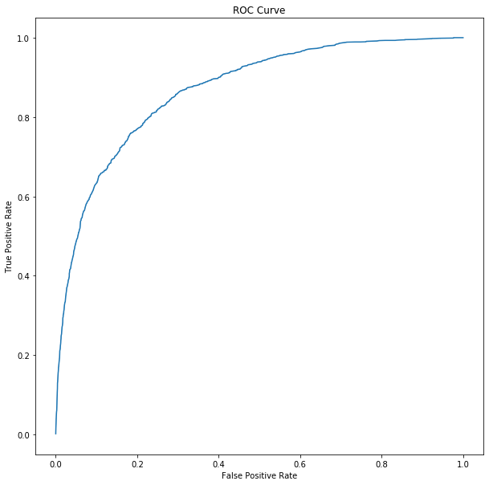
Performance
Model AUC:
  Training: 87.541
  Validation: 86.863
Model Lift:
  5%: 7.354
  10%: 5.565
Overall model performance is strong in terms of both AUC and lift

Slide 33
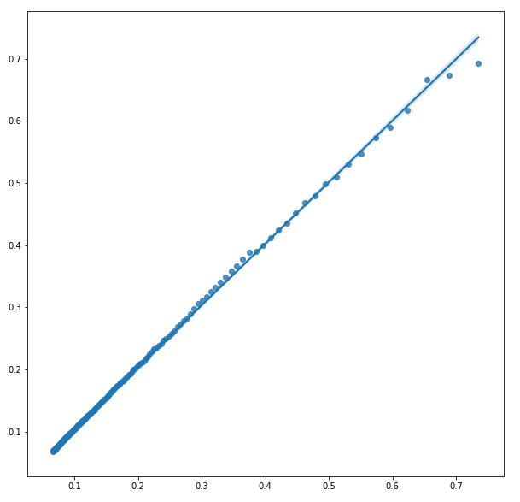
Calibration
Plotting average prediction vs average default rate we can see the score is generally well calibrated.
R^2: 99.78%

Slide 34
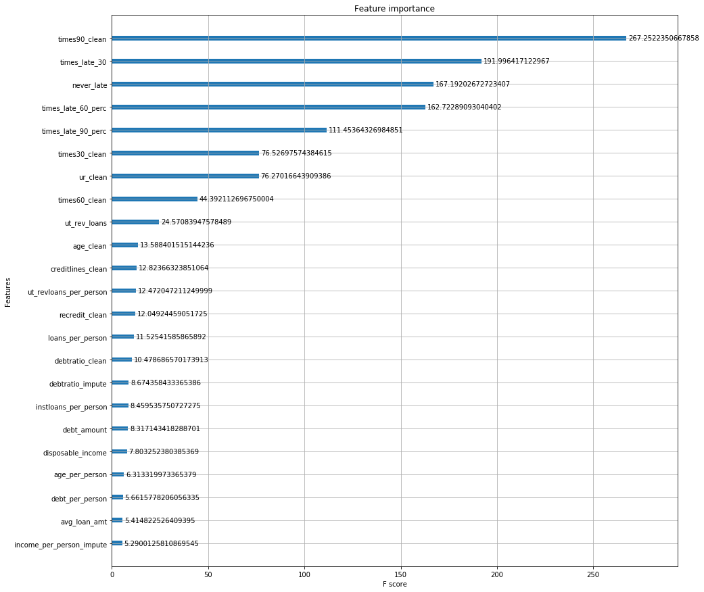
Model Features
Feature importance by gain:
As expected here we can see that the performance of the model is largely driven by previous delinquency.
Age and credit utilisation rate appear to have the greatest effect after delinquency

Slide 35
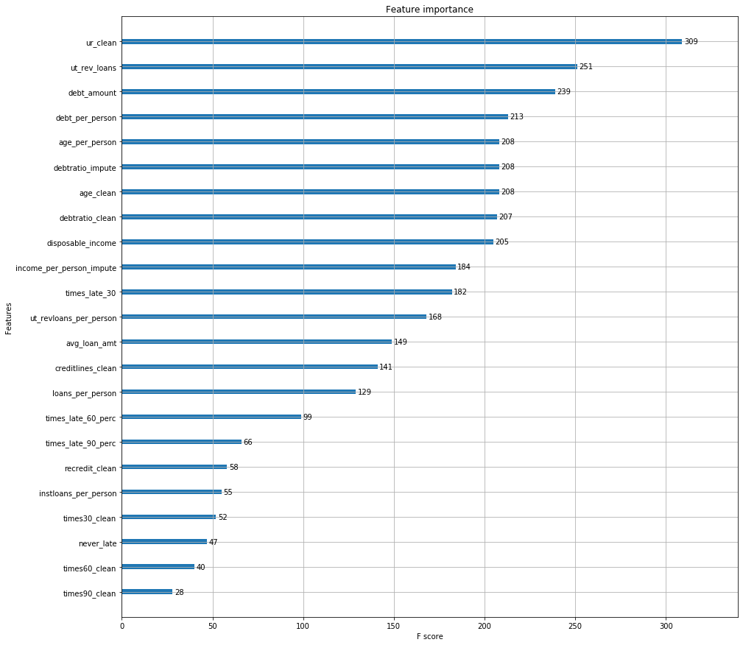
Model Features
Feature importance by weight:
In contrast to the gain chart we can see that utilisation, age and debt are the most prominent features in the trees

Slide 36
Model vs Variable lift
The table to the right shows the lift of both the model and several high lift variables.
In this particular case, we can see that the model out-performs each individual variable.
If the purpose of our model was to help accept/reject customers for loans, we can see that the model would reject more bad customers and accept more good customers than if we were to apply a hard check on any of our individual variables.
Generally, variables such as previous delinquency are used to reject clients before the model, as they provide better lift.

Slide 37
Conclusion

Slide 38
Recommended changes to approach
In general, the model performed well in terms of predicting default and had excellent lift. However I would like to highlight the following things which I would change if this were a real model build:
Gather more business context about how the model is to be used to tailer the analysis to that use case
Dig into the reasons for issues with variables to understand how they should be treated and expectations for model inputs in a production environment, especially for those that are predictive
Addition time/effort spent on creating new features and exploring cleaned data
Use better methods of feature reduction such as using feature importance in the model to guide which features should make it to the final model
Test multiple models and combinations of models
Parameter tuning of the model using cross validation and searching algorithms
If the purpose of the model were for accept/reject decisions, make data exclusions before modelling for items that would prevent the customer from getting a loan automatically:
  Apply a maximum age
  Apply a minimum disposable income to service the loan
  Apply a max previous delinquency amount/number

